Slide 1
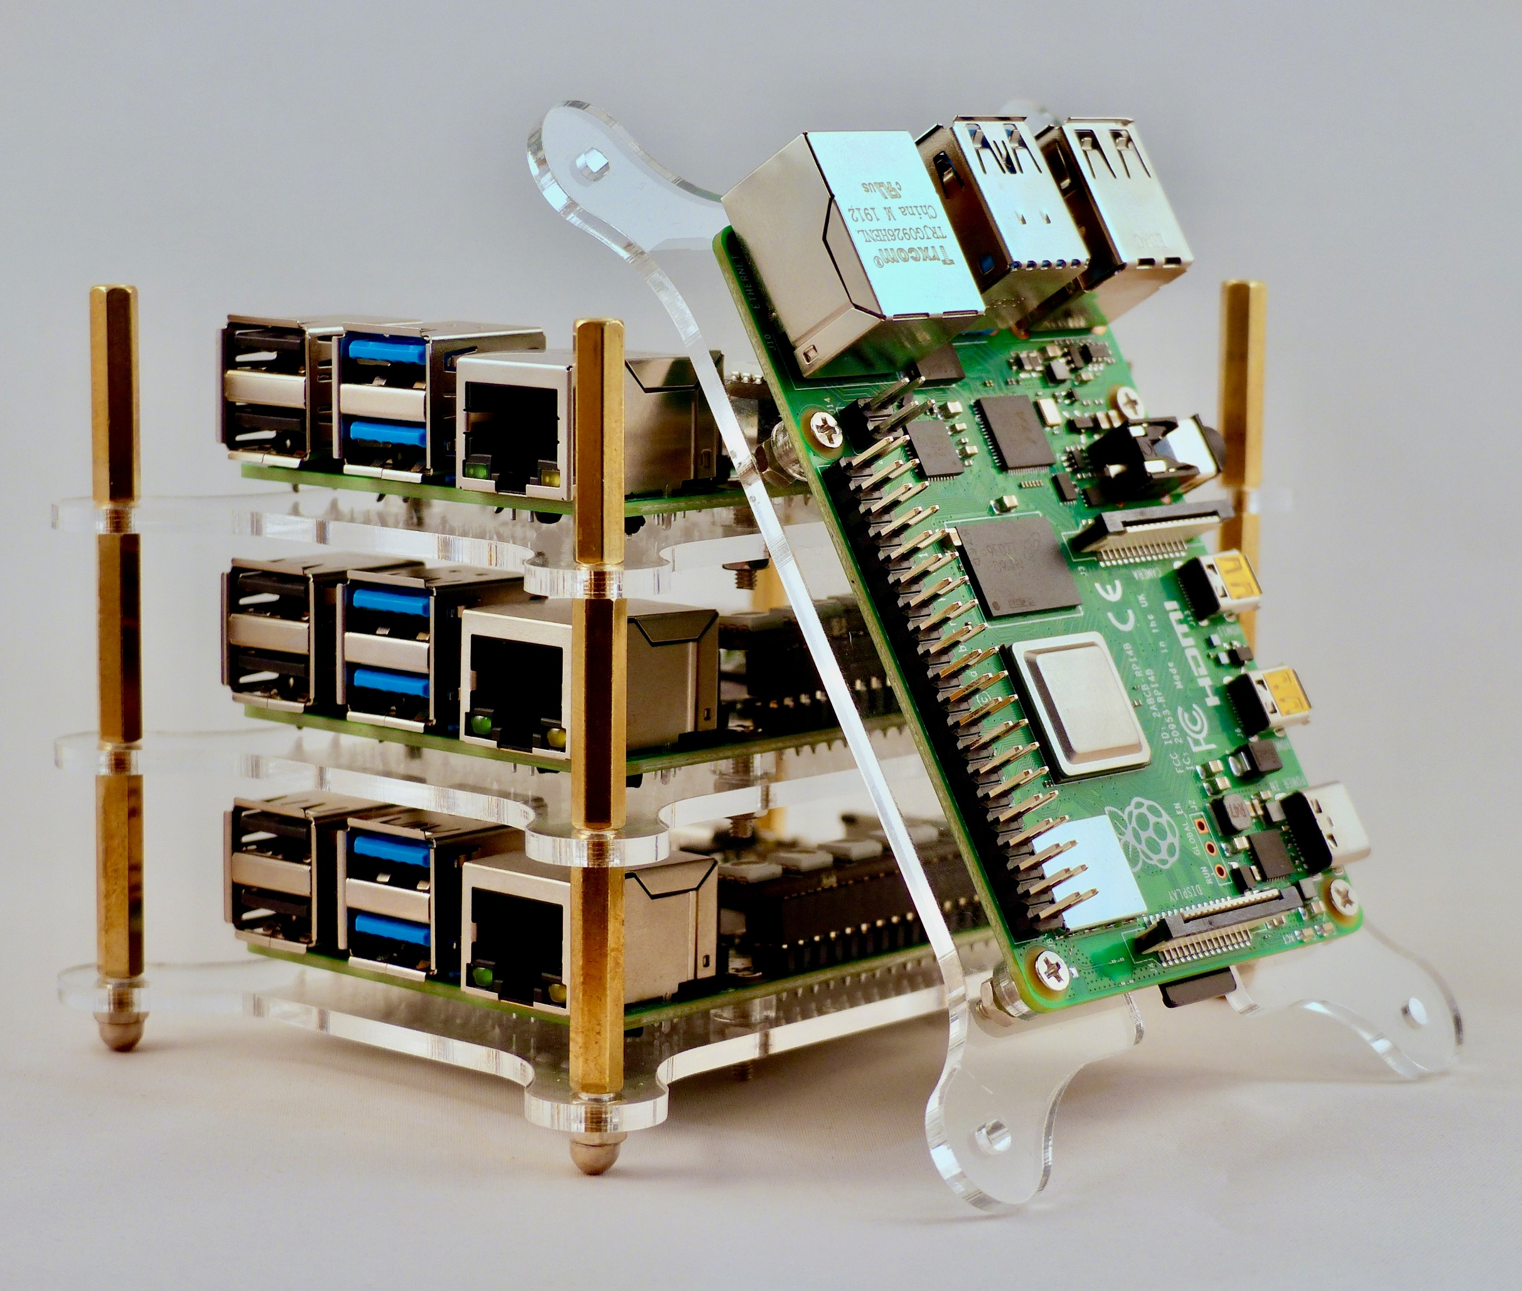
Cluster Networking What is it?
This is a cluster computer ---->
From observing, it consists of at least 3 Raspberry Pi’s and they are adding another.

Slide 2
A Cluster is a useful methodology of abstraction when it comes to many computing devices in a network(s).
Instead of a grid of computers on a network that donates their unused resources to the others, a Cluster is a group of devices with resources that are accounted for and bounded.
Rather than each component of a network being a flexible, multi-tasking computer, a Node in a cluster can be thought of as a single, dedicated worker device.
Pods are the logical hosts runs the operations of nodes. Nodes can have multiple Pods.
Masters are special nodes that manage the cluster through scheduling Pods.
Nodes and clusters can be tightly or loosely coupled (Data Dependence varies).

Slide 3
Why do we care about Cluster Networking anyways?
Clusters can use all of the nodes in the network to allow the use of clever scheduling and a brute force approach to speed up a lengthy or demanding tasks.
If anyone has ever had Internet that was Dial-up, DSL, or Satellite-based, you have felt the pain of the lack of clustered networks.
It has evolved society such that humans that can stream videos at the same time as loading it!
Other necessities of include: Performing computations in real time, Playing live video games together with servers, like Fortnite, or Automating tasks, like the many robotic arms that organize countless warehouses for Amazon.

Slide 4
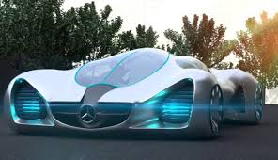
Practical Example of Cluster Networking
Imagine that all cars are automated and you are going to MSU during heavy traffic.
You get in your car (Node) and as you approach traffic (Cluster), there is a computer (Node) that schedules the traffic (several nodes) around your car.
Can you imagine how efficient traffic would be if it was scheduled by a computer? We probably wouldn’t even need stop lights anymore!

Slide 5
Wow, that is pretty cool. How does it work?
A Pod is an isolated group of local containers for storage and specifications on how the containers are to be used. Once a pod is scheduled to a node, the node begins computations based on how the pod is interfaced.
Several nodes can simultaneously execute instructions within the cluster for all nodes to do the exact same task or be scheduled in a way that uses parallelism and the pipelining of many nodes to perform a unique set of operations to achieve a certain computational goal.
A loosely coupled system is less data dependent, meaning a node does not need to know what another node is doing, where a more tightly coupled would be the opposite.

Slide 6
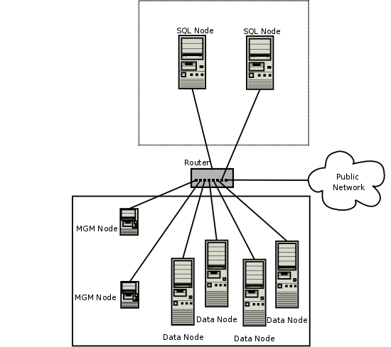
A Visual Example Based on the SQL Nodes, this is a database. Video games use databases, so this could be the Fortnite server architecture.

Slide 7
So Typical……
Nodes are in a LAN configuration and connected together with a high-speed bus in a centralized network topology.
Nodes are dedicated to a single task.
The composition of Nodes in a Cluster is a unique Operating System.
Nodes use the same hardware and Operating System, though not always, like OSCAR (Open Source Cluster Application Resources).
Clusters are created to increase memory, redundancy, and performance.
Cluster software is developed to be super efficient with its resources.
Cluster systems are much cheaper and easier to expand.

Slide 8
WORKS CITED
Wikipedia contributors. (2020) "Computer cluster." Wikipedia, The Free Encyclopedia. Accessed 05/02/2020. https://en.wikipedia.org/wiki/Computer_cluster
Anand. (2019). “Pod vs Node in Kubernetes“. Medium. Accessed 05/01/2020. https://medium.com/developerworld/pod-vs-node-in-kubernetes-26c858988f94
The Kubernetes Authors. (2019). “Concepts“. Kubernetes. Accessed 05/02/2020. https://kubernetes.io/docs/concepts/architecture/nodes/
Plumer. (2016). “How self-driving cars could make traffic lights obsolete, in one unsettling video“. Vox. Accessed 05/01/2020. https://www.vox.com/2016/3/29/11324690/self-driving-cars-intersections
читање. (2019). “Run tasks concurrently to maximize usage of Batch compute nodes“. Microsoft. Accessed 05/02/2020. https://docs.microsoft.com/bs-cyrl-ba/azure/batch/batch-parallel-node-tasks
Chalke. (2019). "Difference between Grid computing and Cluster computing". GeeksforGeeks. Accessed 05/03/2020. https://www.geeksforgeeks.org/difference-between-grid-computing-and-cluster-computing/

Slide 9

Hope you Enjoyed the Presentation!!

